Slide 1
Assignment #3: Blending
Josh Adams
CS6475 - Fall 2019

Slide 2
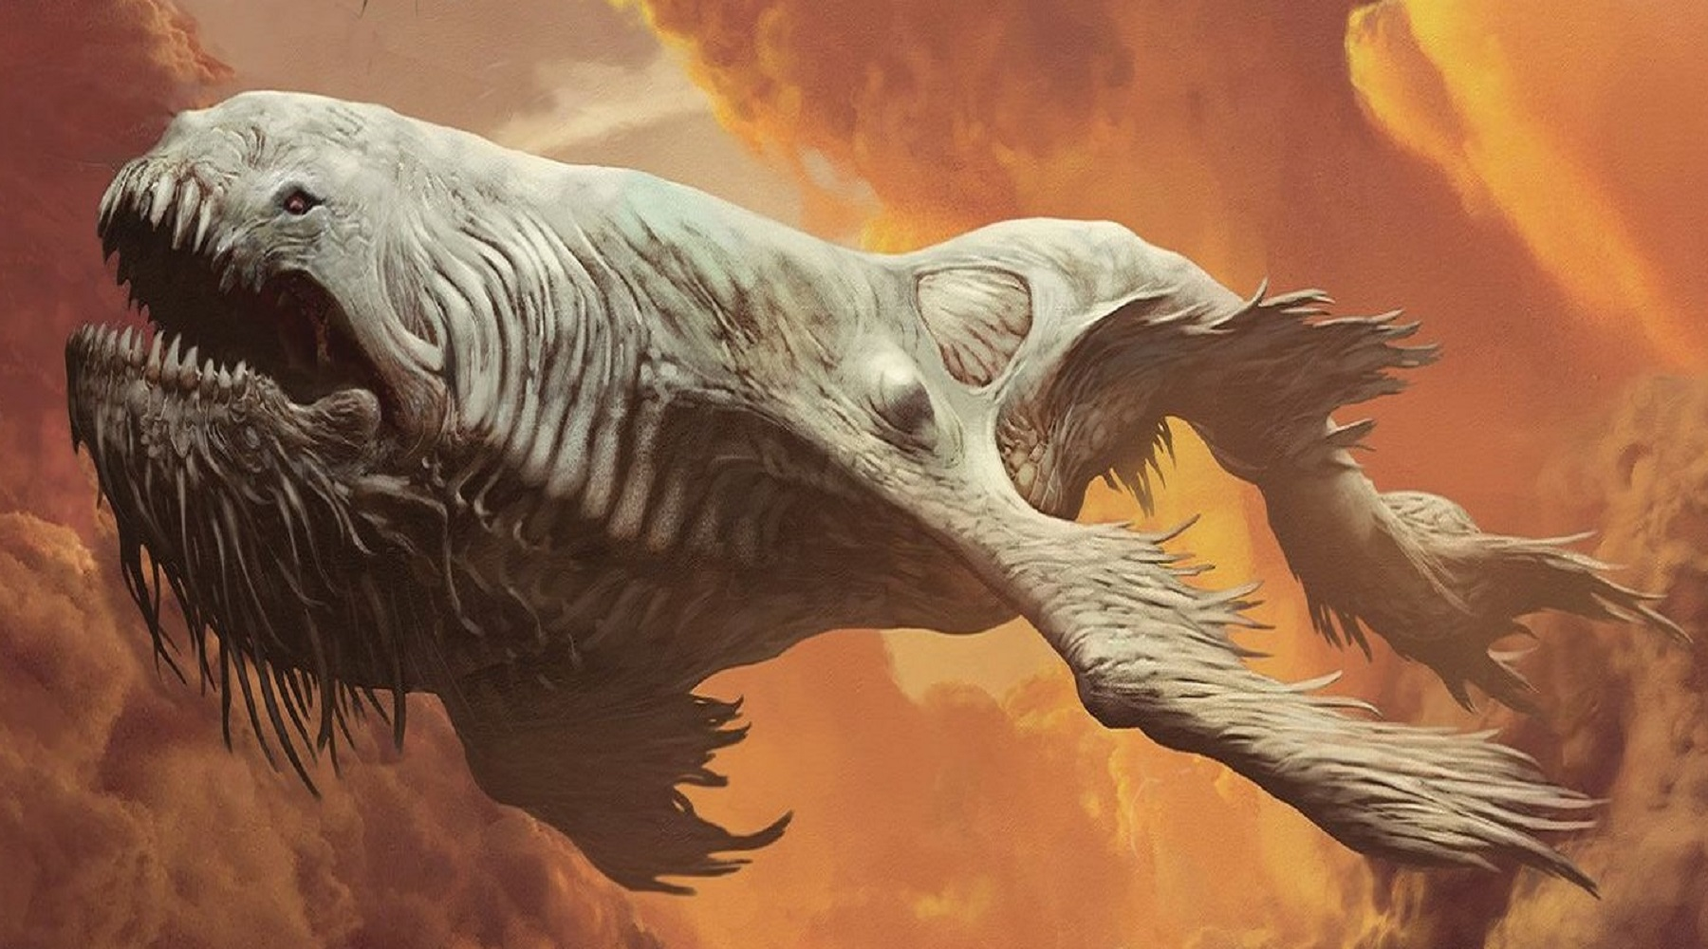
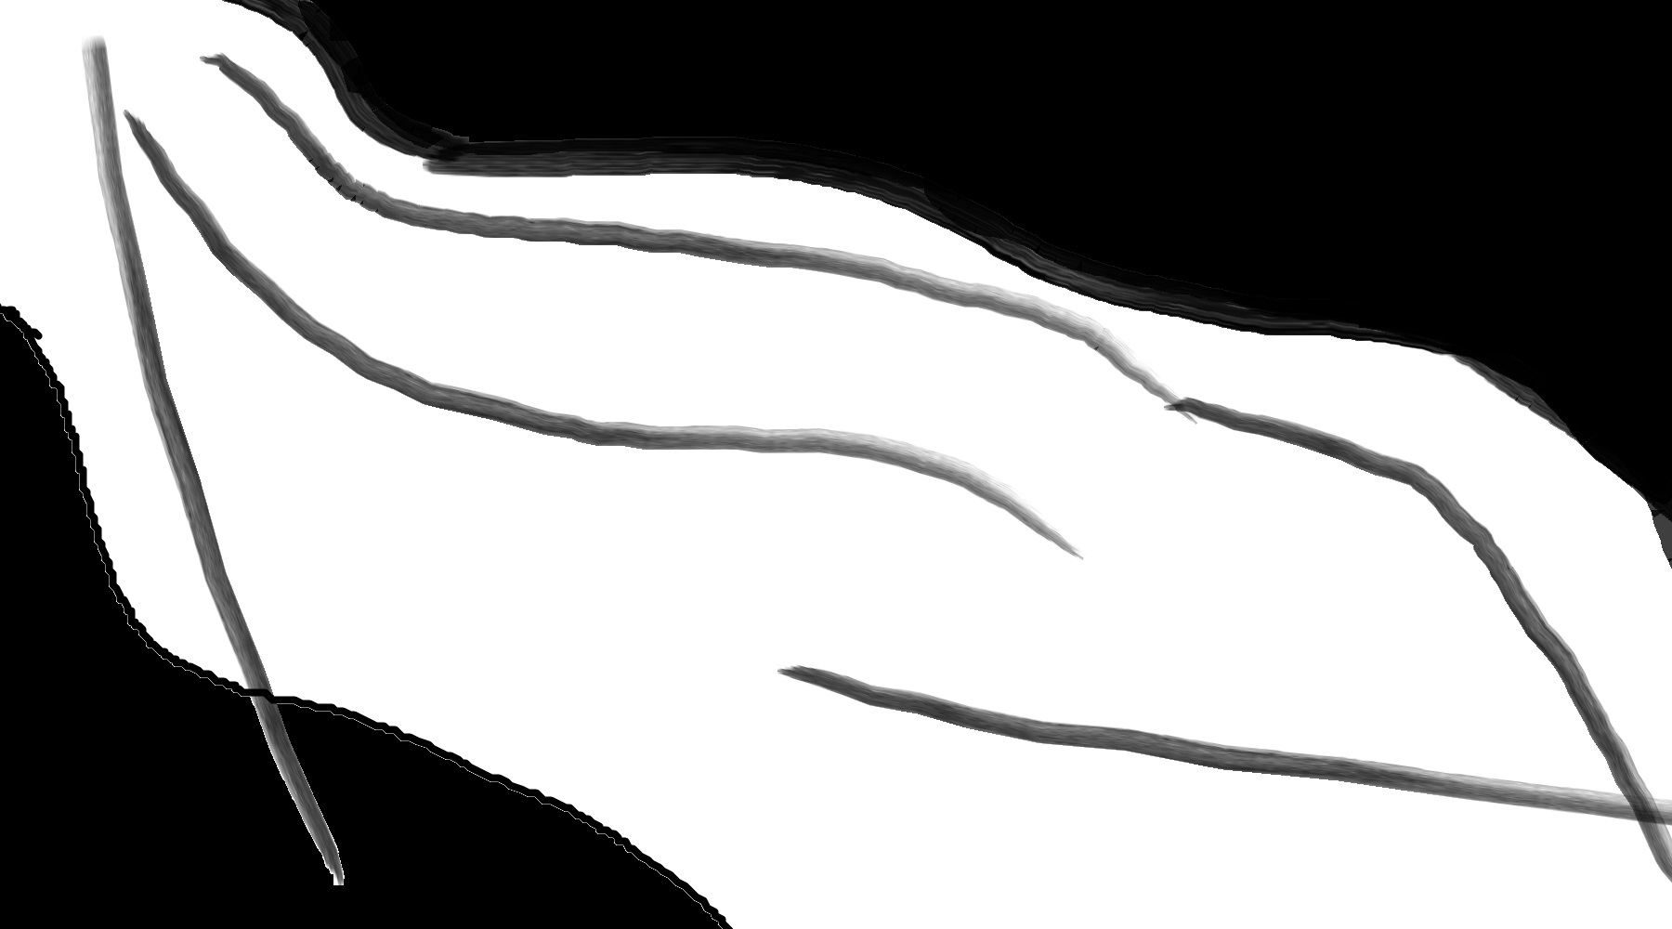
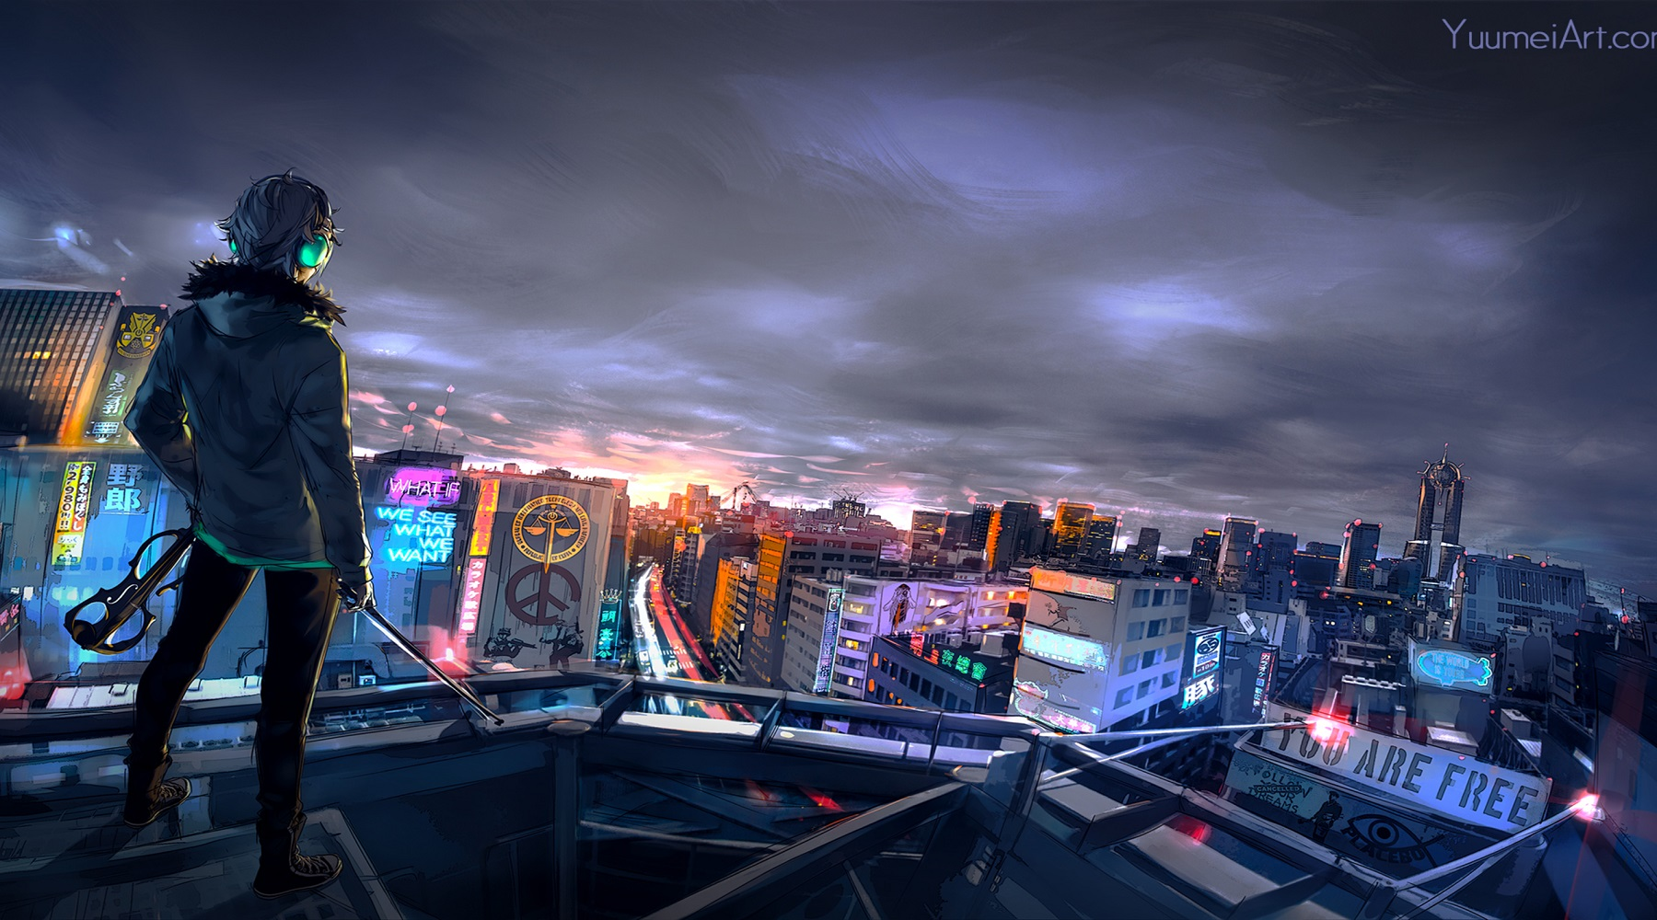
Input Images
Black Image
Mask Image
White Image
What is the subject of your images? Did you take your own pictures?
The black image is from the short sci-fi film ‘The Leviathan’ and the white image is a cyberpunk cityscape from www.hdqwalls.com. I did not take my own pictures.

Slide 3
Mask
How did you create your mask?
I used Microsoft paint to make the mask.

Slide 4
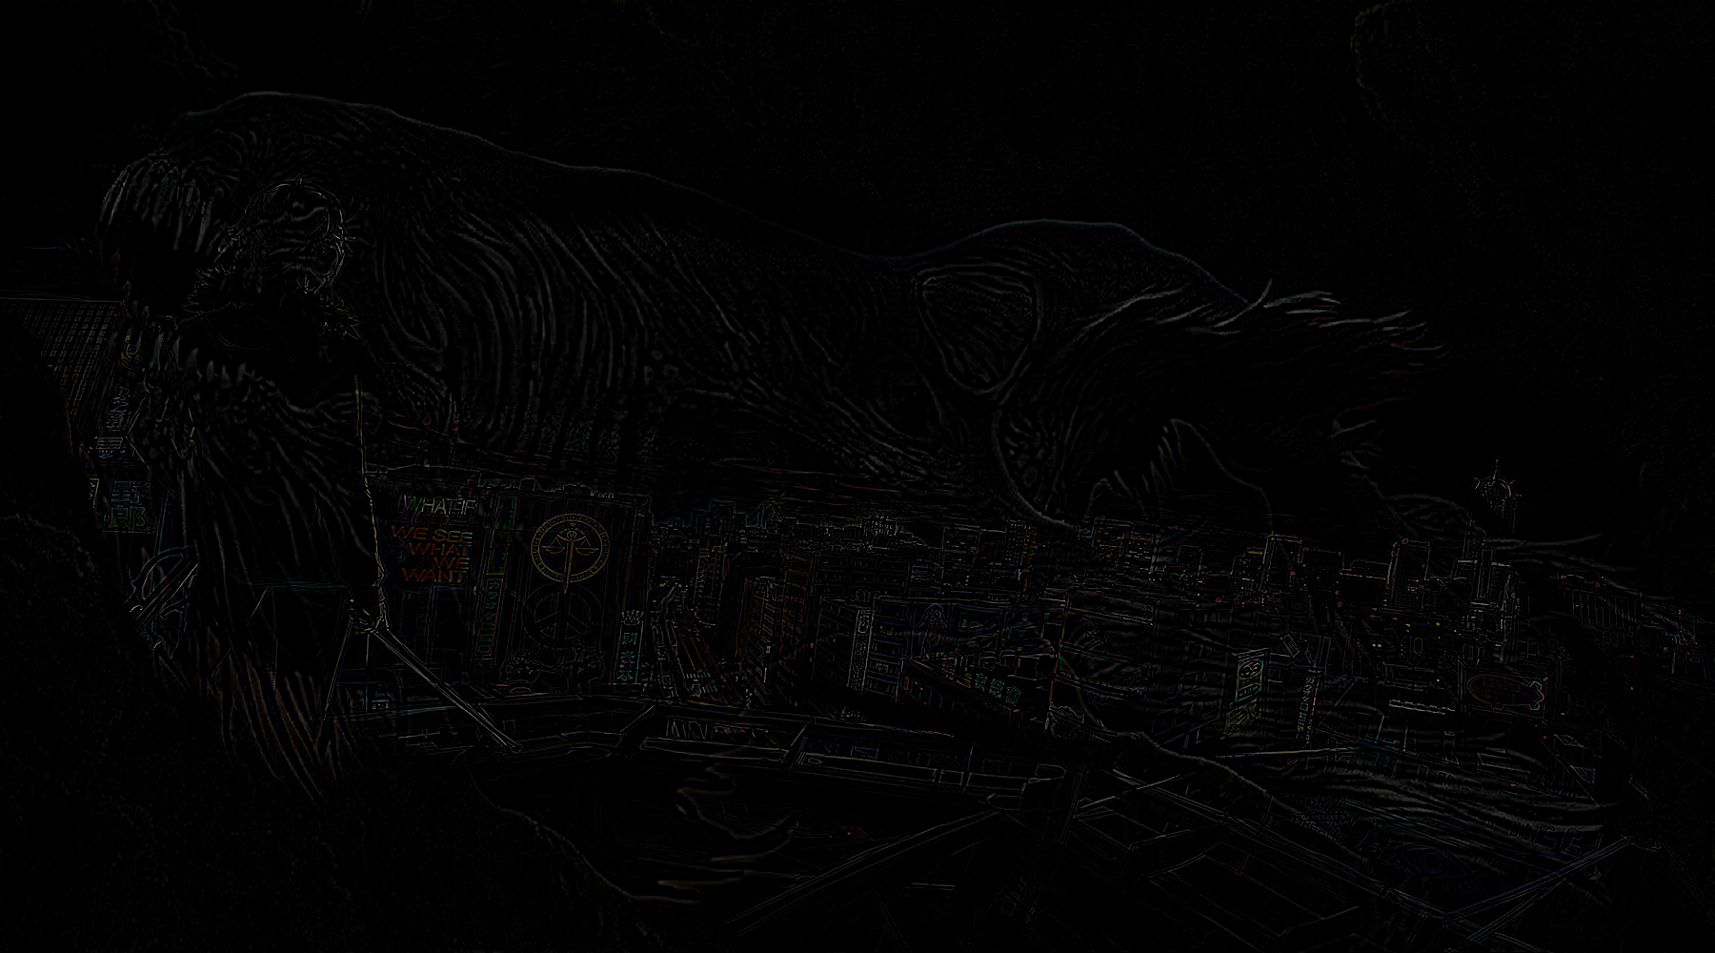
Final Blended Image
Caption:
“The Monster”

Slide 5
Blend Discussion
How did you determine precisely where to make the blend?
I used a lot of trial and error to get in the general area I was interested in. I also looked at the various color channels as well as OpenCV has many different color maps you can use which make images look different. This can allow for different areas to be segmented in many cases
How might you automate the location of the blending point?
A way to automate the finding of the blending point could be to use something like canny-edge detection coupled with a K-means clustering algorithm. This would be to group together edges in groups and apply blending based on those groups
Do you think that blending or using a cut (as discussed in Lecture 4-04) is a better approach for your input images? Why?
I believe that blending was the better approach for my images

Slide 6
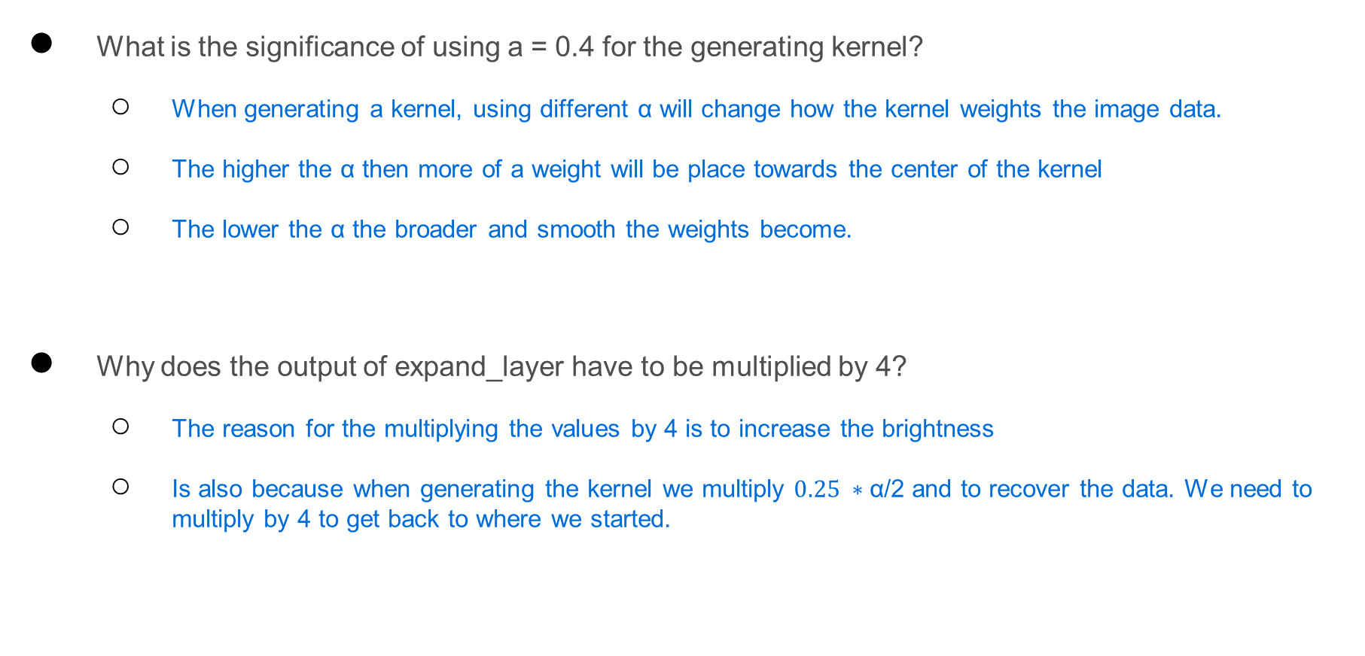
reduce_layer() & expand_layer()
What is the significance of using a = 0.4 for the generating kernel?
When generating a kernel, using different α will change how the kernel weights the image data.
The higher the α then more of a weight will be place towards the center of the kernel
The lower the α the broader and smooth the weights become.
Why does the output of expand_layer have to be multiplied by 4?
The reason for the multiplying the values by 4 is to increase the brightness
Is also because when generating the kernel we multiply $0.25 ∗\text{α}\text{/2}$ and to recover the data. We need to multiply by 4 to get back to where we started.

Slide 7
Successes and Improvements
Did your blended image come out as expected? What were you most happy about with your final result? Be specific and explain.
My blended images did not come out the way I had expected. It lacks color and I still have not been able to resolve this issue.
I was happy with the combination of the two images overall because the way the monster shows faintly through.
Discuss at least 2 improvements you would make to your final blended image (from template slide 5)?
I would fix the color issue because when the two images are blended, when they have color it looks much better.
I would have used larger images to try and produce better results in detail

Slide 8
Resources
Record your sources here. We accept all reasonable formats that would allow us to verify your sources.
Piazza posts, specifically Nicholas Lombardo was very helpful
A Multiresolution Spline With Application to Image Mosaics by Peter Burt and Edward Adelson
The Laplacian Pyramid as a Compact Image Code by Peter Burt, Edward Adelson
Udacity Videos
‘black.jpg’ – an image from a short film ‘The Leviathan’ directed by Ruari Robinson
‘white.jpg’ – a ‘cyberpunk cityscape’ from www.hdqwalls.com

